Slide 1
PRIMARY_DIAG numerator
SQL from SAS:
/* PRIMARY DIAGNOSIS */
CASE
WHEN CDE_ENC_REC_IND <> '0'
AND CLAIM_TYPE IN ('I',
'M',
'O',
'L')
AND primary_diag NOT IN ('+', '-', ' ')
THEN
1
ELSE
0
END
AS PRIMARY_DIAG1,

Slide 2
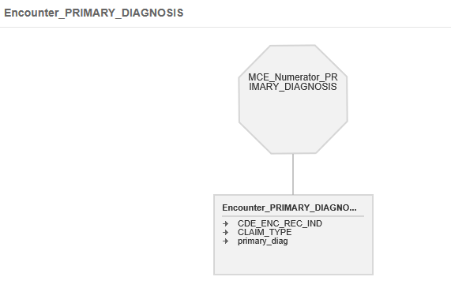
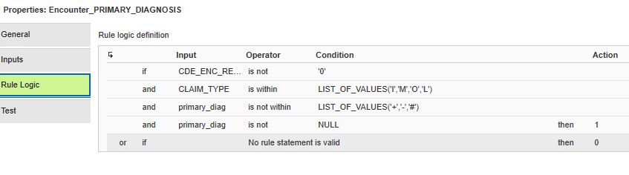
Pass 1 Rule Specification

Slide 3
SQL re-written for Mapplet
IIF (( CDE_ENC_REC_IND <> '0' AND IN(CLAIM_TYPE ,'I','M','O','L') AND ( NOT IN(PRIMARY_DIAG,'+','-','') ) ),1,0) : PRIMARY_DIAG1

Slide 4
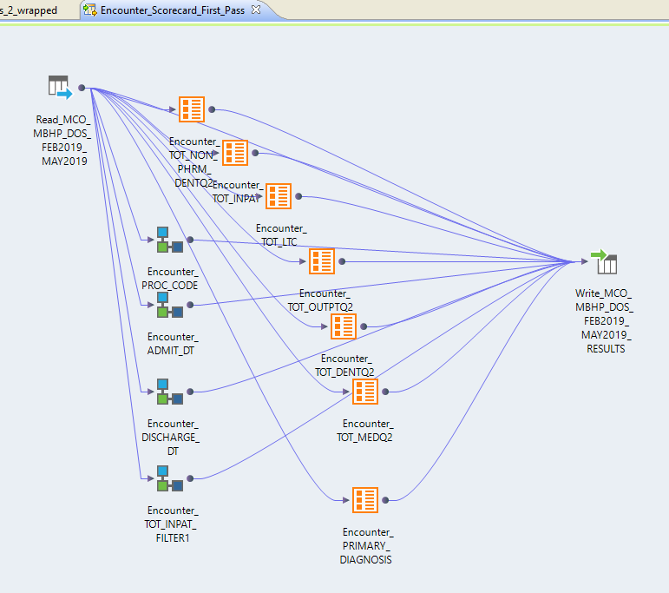
Pass 1 - Mapping for Primary Diagnostic, Admit Date, Discharge Date and Proc Code

Slide 5
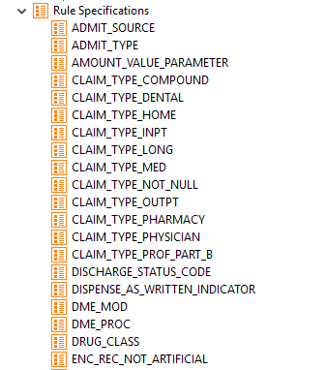
Pass two - breaking into parts

Slide 6
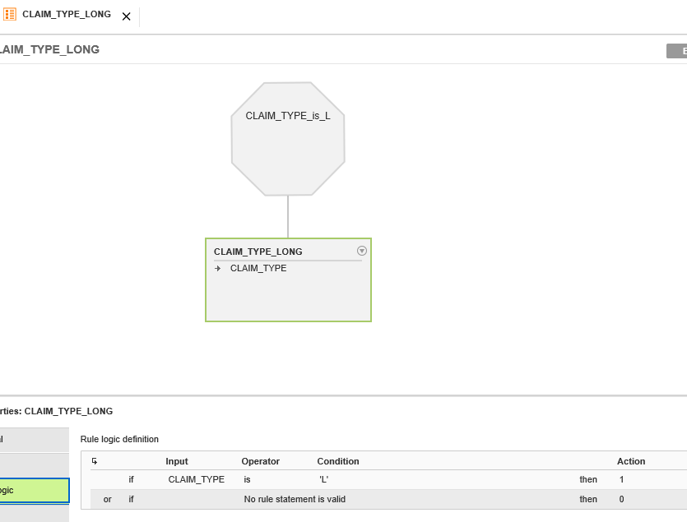
Lowest level – Claim Types – Claim Type L

Slide 7
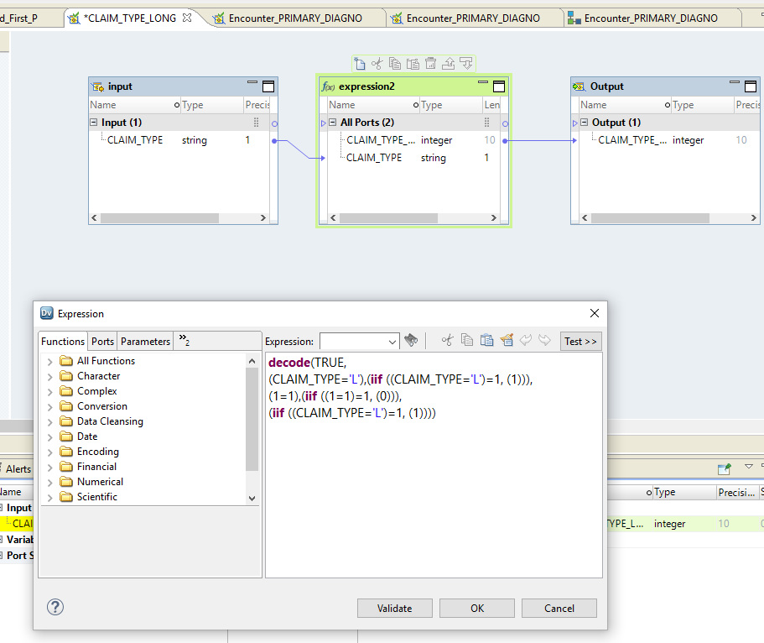
Claim Type L Mapplet– for wrapper mapplet

Slide 8
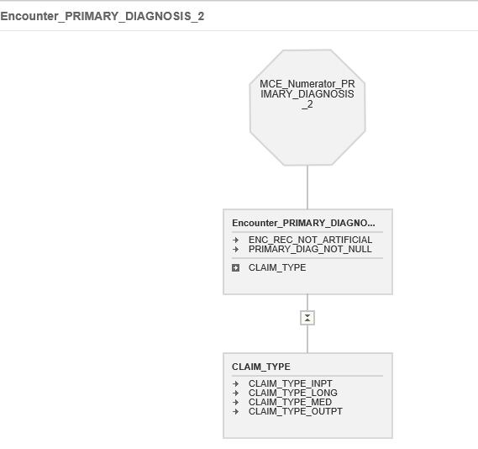
Rule Spec combining lowest level pieces

Slide 9
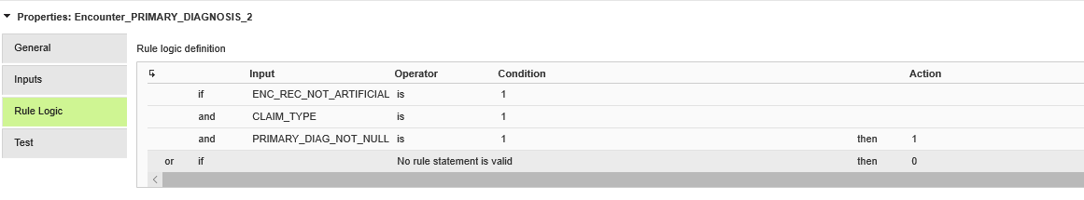
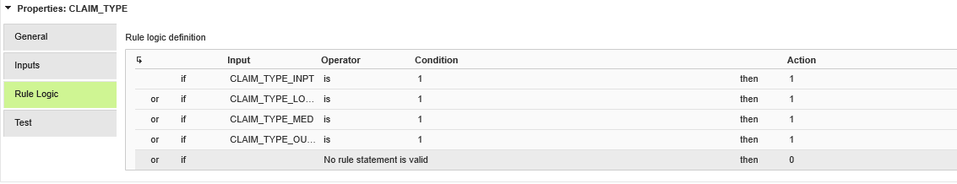
Rule logic for Rule Spec

Slide 10
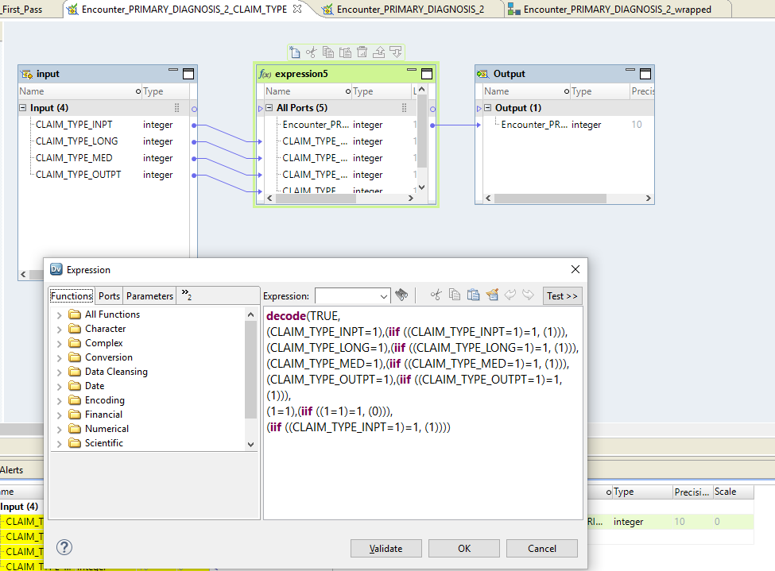
Claim Type Mapplet from Rule Set

Slide 11
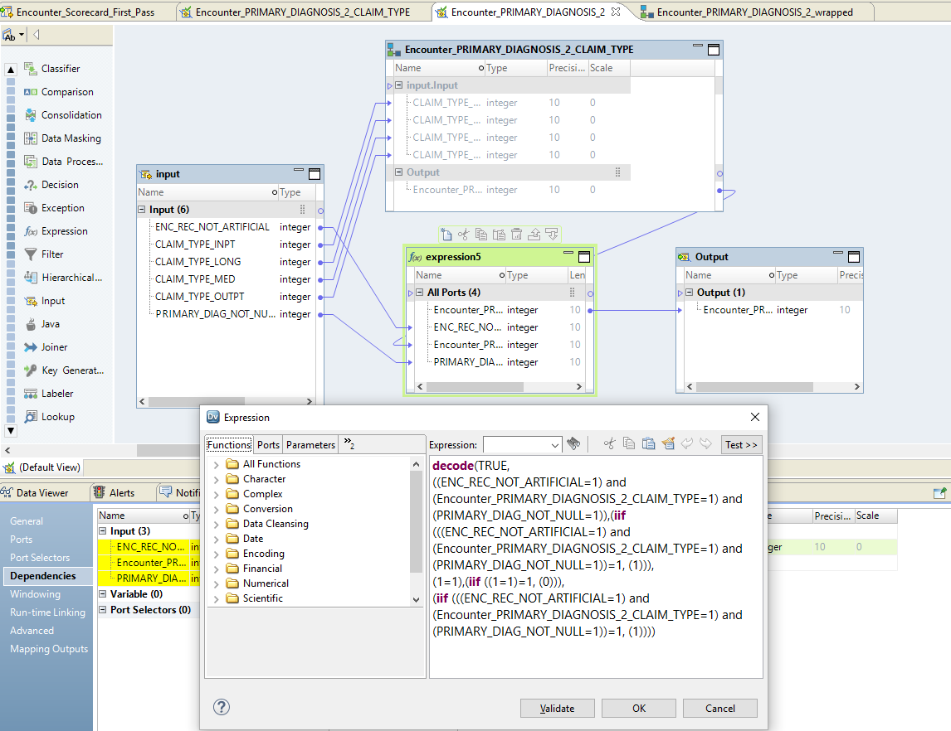
Head Mapplet from Rule Set

Slide 12
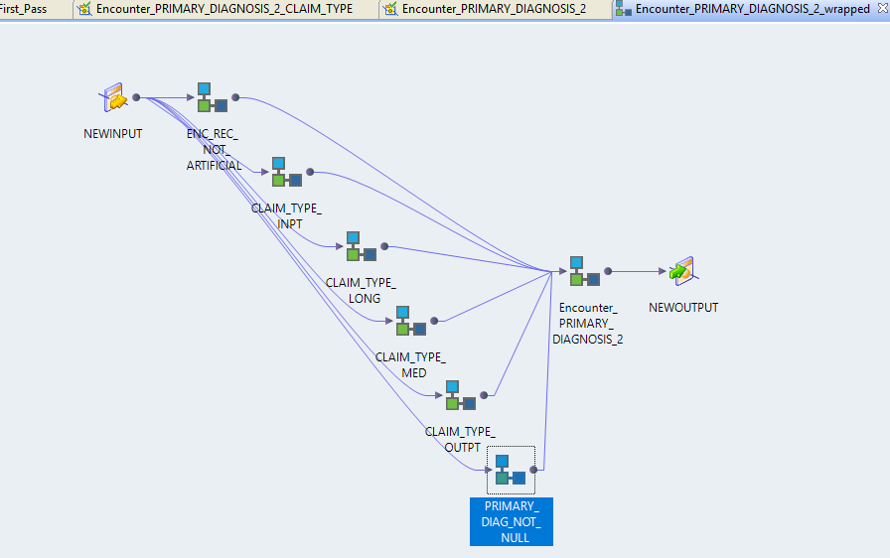
In order include base mapplets need a wrapper mapplet

Slide 13
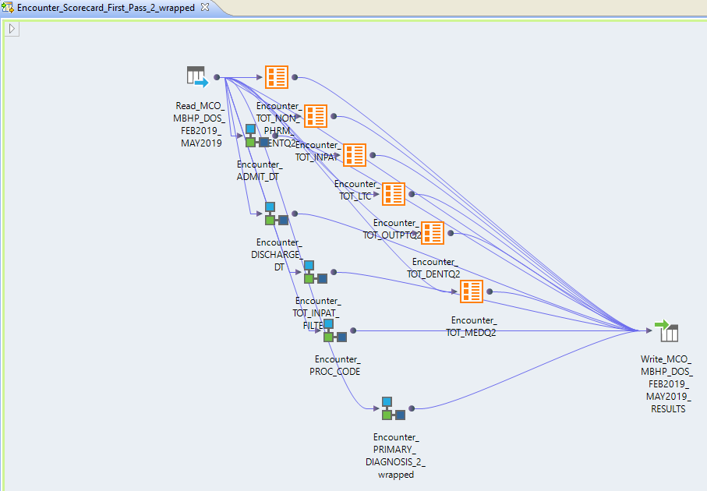
All that to add one piece to the mapping

